Slide 1

Pupil Mental Health and Wellbeing
“A state of wellbeing in which every individual realises his/her own potential, can cope with the normal stresses of life, can work productively and fruitfully, and is able to make a contribution to his/her community”
World Health Organisation definition

Slide 2
WHAT DID WE DO?
Investment and Training
Emotional Literacy Support Assistant in school (ELSA) – offers 1:1/ group counselling and also trained in Lego and art therapies
ELSA is Mental Health First Aid trained
Art of Brilliance – Embedding positive mental health and wellbeing.
The Hive – Nurture based provision set up for children who require more personalised learning to support SEMH.
Completing Wellbeing Award for Schools – looking to appoint Wellbeing Ambassadors – child led
Jigsaw scheme covers new RSE – SMSC embedded as part of our curriculum
Forest school
Regulation stations/ calm spaces in all classrooms
Rainbow room as a dedicated calm space and support offered from ELSA
Working with external agencies/ professionals

Slide 3
What did we do?
Curriculum
Weekly mindfulness and wellbeing sessions (Jigsaw)
CalmBrain – assists with healthy brain function and emotional wellbeing
Assemblies linked to values/growth mindset/mental health & wellbeing
Forest school sessions for each year group
Ensure PE quota
Celebrating enrichment days - Wear yellow day to highlight mental Health awareness, Mental Health Week
Quality First Teaching – so that the needs of the children are met
Workshops provided for pupils from Mind (Mental Health charity).

Slide 4
What did we do?
Behaviour Policy
Updated Behaviour policy
Behaviour Plans – agreed with child and shared with families
Praise in Public and Reprimand in Private
Class Dojo reward system – individual and class rewards
Regulation stations in every classroom and Rainbow Room
Emotion Coaching techniques shared with all pupils, staff and parents (Art of Brilliance)
Transition
Thorough handover shared with new teacher by the end of summer term,
Transition day at the end of the summer term, start earlier for children who require it
Safeguarding
Supporting pupils and ensuring essential information handed over to high school for children moving on to their secondary education

Slide 5
COVID
We have been able to offer the support to children and their families
Trust between staff and families which has allowed us to make Tier 2 referrals when needed
Drop in sessions with ELSA once back in school have been invaluable for anxious children
Lego/ play therapy
Spending time with the school dogs
Mindfulness
Recovery curriculum focused on Positivity – looking for the positives and building resilience

Slide 6
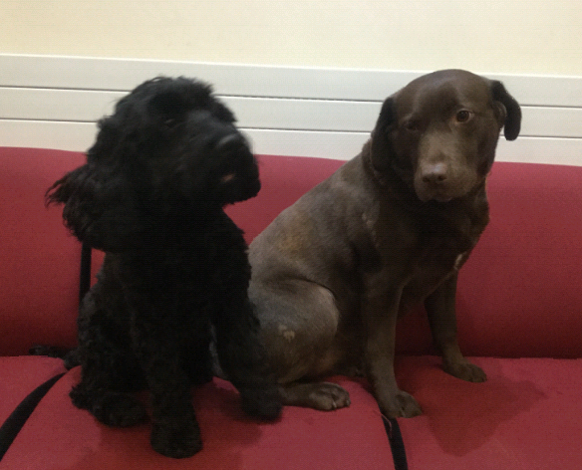
Our school dogs
Help to teach empathy and appropriate interpersonal skills
Help children develop social skills
Help to quickly build rapport between adult and child
Increase in school attendance
Decrease learner anxiety
Improved motivation
The dogs give the children unconditional love and affection which helps them to express their feelings

